Slide 1
An Effective Restaurant Recommendation App
EATUP

Slide 2
Our Team Content
Advisor：Dr. Wenjia Li
01
Background Information
Chenjia Qian
Bo Wei
Xiaolei Li
Jiangwei Qing
02
Database
03
Map-Function
04
Algorithm
05
Evaluation
06
Demo
Notes:
Plz allow me to brife introduce our team. Myself….major…used to be what major…
Next person intro

Slide 3
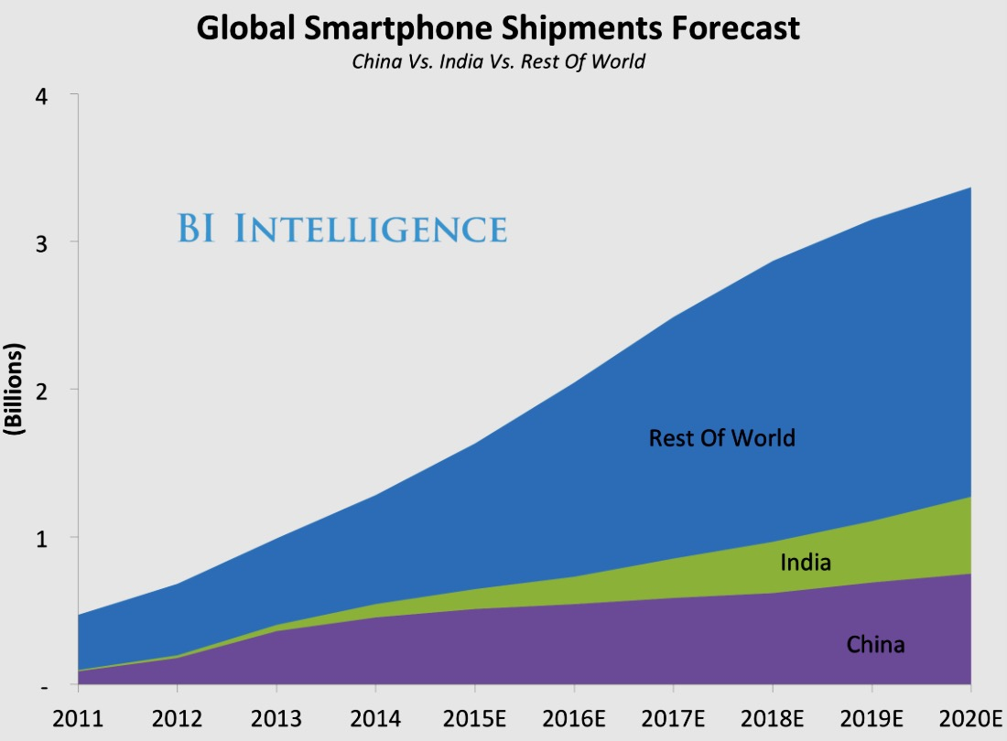
Background Information
BI Intelligence[1] suggests that there will be about 2,100 million smartphone units shipped in 2020, growing at 6% annual rate during 2016-2020
The Apple App store has close to 2million apps while Google play has over 2.2million Apps. This number is expected to increase in the future.
Gartner’s[2] prediction narrates that over 268 billion mobile downloads will generate an income of $77 billion in 2017.
Notes:
The increasing number of smartphone users in the global market has led to a tremendous increase in the number of apps that consumers use on their phones.

Slide 4
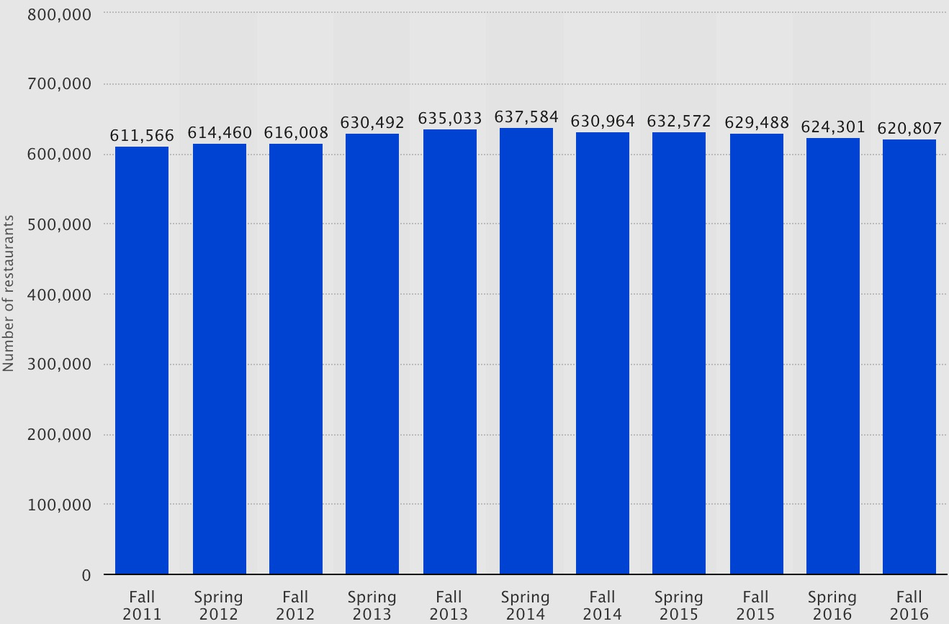
Current Market
The market for restaurant recommendation app has not been fully developed while the demand for such app is huge
Dine at restaurant:
28% More than once a week
24% Once a week
27% 2-3 time a month
Result base on survey over 500 Americans (SurveyMonkey)
Number of Restaurants in US
By-Statista.com

Slide 5





The Significance
Going out for lunch or dinner?
The market leading restaurant App, such as Yelp, provides mostly crowd-sourced reviews about local businesses.
Time consuming and inefficient
Conflict between friends
The choice is not what you want
Notes:
Imagine now you want to go out for lunch or dinner. Where would you go? Yes, you could say that you only go to the place you know. But what if you what a change or your frinds might not wanted to go there? Search on Yelp or Google Map will also take you quite a long time. So, by using our app, the recommendation i make only in seconds. Lets now see how our app works and how it really can help in our daily life and makes eating in a different restaurant a real enjoyable thing. Now I will hand over to my teamate, to decuss the design and functions of our app in more details.

Slide 6
Our Approach
Restaurants are recommend based on personal preference
Restaurant result shown in seconds
Only nearby restaurants are shown to user
Additional function and feature can be added in the furture
Eg: Recommend friends with similar taste of food

Slide 7
Database

Slide 8
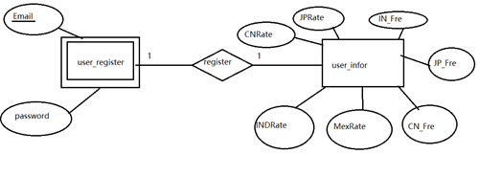
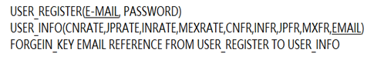
Database Design
E-R Diagram
Relational schema

Slide 9
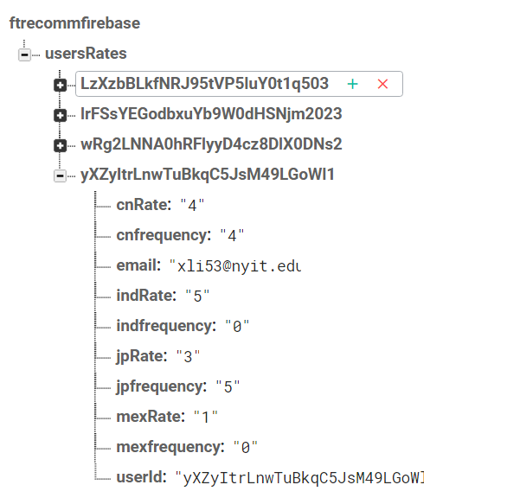
Database implement
Why Firebase(security, efficiency, usability)
Basic manipulation of the data base(insert, update, retrieve)
The Jason tree structure of our database

Slide 10
Map

Slide 11
Map project
1.what’s the Google map and Google map API?
Google Maps is a web mapping service developed by Google
Google maps began as a C++ desktop program, The service's front end utilizes JavaScript, XML, and Ajax
Google maps API allow embed Google Maps site into an external website, on to which site specific data can be overlaid

Slide 12
The goal of the map project
Get the current location
Fused location provider analyses GPS, Cellular and Wi-Fi network location data in order to provide the highest accuracy data.

Slide 13
Get the nearby restaurant list
Use Url function to get information about nearby restaurant on Google maps. This URL is made according to Google Developer Guide for nearby places

Slide 14
Optimized the map function
Add more detail information which supported by the Google map API or Google place API to the nearby restaurant
Design the marker UI. Transfer and store data

Slide 15
Algorithm

Slide 16
01
Approach of Recommend
04
Comparision
02
Collaborative Filtering(CF)
05
Our Algorithm
03
Cosine Similarity

Slide 17
Approach of Recommend
How computers know what people want before their operation?
It comes out a information filtering system which can predict users’ preference or rating on a specific item or a kind of item type.
We can tell that recommendation system is not designed to give people what they want, it’s designed to give people what it thinks they want which is based on what user and other users have liked or wanted in the past. Which means the system do not surprise users, it does not take users out of their comfort zone.

Slide 18
Approach of Recommend
How computers know what people want before their operation?
The idea originated with Tim Westergren, one of the founders of an Internet radio service, Pandora. Each time when a new song pop out, a trained musician goes through a list of attribute and assigns a rate, analyzing songs may take around 20 minutes.[1]
The purpose of the music genome project is aimed to make prediction about the types of music user may want to listen next.
It comes out a information filtering system which can predict users’ preference or rating on a specific item or a kind of item type.
We can tell that recommendation system is not designed to give people what they want, it’s designed to give people what it thinks they want which is based on what user and other users have liked or wanted in the past. Which means the system do not surprise users, it does not take users out of their comfort zone.

Slide 19
Collaborative Filtering (CF)
User A shares the similar preference with you, so you may like what A likes
The collaborative filtering can also called rating or social filtering. As an significant part of e-commerce, it can recommend users to buy possible-liked items based on users’ previous shopping behaviors and their similar users’ rating information.
The approach of it is based on collecting and analyzing a large amount of data of users’ preference or behavior, and predicting what a targeted user will like by finding other individuals with most “similar” preference.
The advantages of collaborative filtering are obvious:
•Shared experience, collaborative filtering is based on other users’ preference which can avoid inaccurate and uncompleted suggestion.
•New information suggestion, collaborative filter can find new things which have different context compared with previous searching, Meanwhile all the suggestions are supposed to be in the users’ comfort zone.
1
2

Slide 20
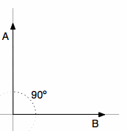
cosine similarity
The cosine similarity is a measurement which measures angle between 2 vectors of an inner produce space.
The result of cosine is expected to less than or equals to 1 for all angles.
When the cosine equals to one, two vectors have exactly the same orientation.
Advantages of cosine similarity:
Not coordinate sensitive, the cosine similarity is focusing on orientation, the absolute position of points may not influence much on the result. Take(3) for example, the result of A=(0, 1) and B=(1.0) equals to the result of A = (0, 1) and B = (3, 0)
N-dimensions supported, the calculation of cosine similarity allows points in a n dimensions space, it can fit the condition which an item contains many types to represent dimensions

Slide 21
Collaborative Filtering (CF)
User A shares the similar preference with you, so you may like what A likes
The advantages of collaborative filtering are obvious:
Shared experience, collaborative filtering is based on other users’ preference which can avoid inaccurate and uncompleted suggestion.
New information suggestion, collaborative filter can find new things which have different context compared with previous searching, Meanwhile all the suggestions are supposed to be in the users’ comfort zone.
1
2

Slide 22
Collaborative filtering 3 steps:
Step 2
Looking for users whose information data is matched with most “similar” rating patterns with the target active user( the user who is required to get recommended).
Step 1
Expressing personal preference by rating items.
Step 3
Using similar user’s preference data, the system recommends items which the similar users have rated but not yet rated by target user.

Slide 23
Cosine Similarity
The cosine similarity is a measurement which measures angle between 2 vectors of an inner produce space.

Slide 24
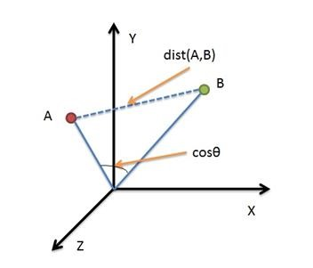
Cosine Similarity and Euclidean distance
The Euclidean distance measures absolute distance among all points in the whole space, directly relevant to each points’ coordinate.
The cosine similarity measures spatial angular, which express the difference of orientation, instead of position.
Advantages of cosine similarity:
Compared with the absolute distance, cosine similarity, can reflect diversity of orientation, not sensitive to absolute value, which means cosine similarity can distinguish users’ interests’ and behavior’s similarity, and fix the possibility of different personal measurement problem.

Slide 25
Our Algorithm
Because of the possibility of variety individual measurement issues, in order to accurately find the similar user who shared the similar preference with the target user, our algorithm for restaurant recommend used vector cosine similarity with n-dimensions.

Slide 26
Our Algorithm
User claim identification
Calculate rate and frequency get values
Put user preference into n-dimensions space
User personal preference tags
Google Map API
Calculate cosine similarity (current user with others)
Most similar user
Use hash table find the max value(<=1), then get the key of max value
Build Map(user ID, cosine similarity value)
Check similar user information
The restaurant predict

Slide 27
Our Algorithm
How it works:
By using keywords searching which is based on Google map API, we can get restaurants’ locations and their types information.
For each kind of types, we can treat them as tags, which can represented a user’s preference on this kind of subjects.
Then set each tag as a dimension, so that we can build a n-dimensions space by n types of tags in the recommendation system.
In the each tag, based on users’ personal preference and walk-in frequency, we can set a value in that dimension.
By getting user’ rate of each tag, multiply by rate of frequency which based on the specific tag divided by total walk-in time.
Because of the possibility of variety individual measurement issues, in order to accurately find the similar user who shared the similar preference with the target usr, our algorithm for restaurant recommend used vector cosine similarity with n-dimensions.

Slide 28
Our Algorithm
For example:
Suppose we have types: Chinese restaurant, Japanese restaurant, and Mexico restaurant, then there will be a 3-dimensional vector space and we can get each user’s coordinate based on user’s information. In this case, the target user’s coordinate should looks like:

Slide 29
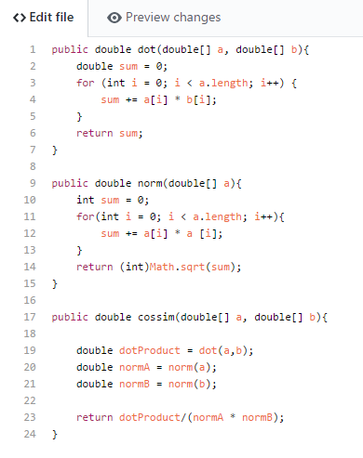
Our Algorithm
Then based on the coordinates of all the users, we calculate cosine similarity between user_A and each other users with code；
After calculating all the cosine similarity between user_A and other users,
Using user id as key, cosine result as value, put these information into a Map data structure. Use HashMap data structure, find the max value.
Then, based on the max value, iterate through the hash map and find the key which is the similar user

Slide 30
Evaluation

Slide 31
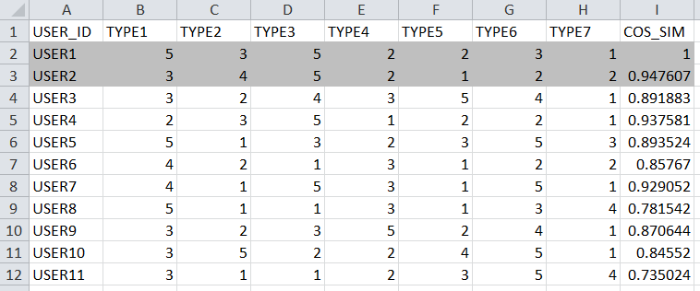
Algorithm Simulation
Our consume
How do we simulation
The process of our simulation
The conclusion

Slide 32
Algorithm Evaluation
3 sets of test
Similarity is proportional to the number of user
Cosine Similarity
Number of User Compared

Slide 33
User Test
Who, How, Amount
Why has partial correct part
The real result
The ideal result

Slide 34
Video Demo

Slide 35
Thank You
Q&A

Slide 36
Terminology
[1]Business Intelligence (BI) comprises the set of strategies, processes, applications, data, technologies and technical architectures which are used by enterprises to support the collection, data analysis, presentation and dissemination of business information.
[2]Gartner delivers technology research to global technology business leaders to make informed decisions on key initiatives.

